Slide 1

Git: A Peek Under the Hood
Matthew Heironimus
Notes:
Assumptions:
You know what a Source Control System is
You have used Git before
You are curious about how Git works

Slide 2
Life Before Git
Notes:
How here is old enough to have used a source control system other than Git?
First Source Control System I Used: CMS (Code Management System) for VAX/VMS systems - https://en.wikipedia.org/wiki/OpenVMS#Development_Tools

Slide 3
Life Before Git
SourceSafe
ClearCase
Subversion
Team Foundation Server (Azure DevOps)
Notes:
Centralized (client–server)

Slide 4
Brief History of Git
Linux Kernel Development - BitKeeper
Started by Linus Torvalds
12/21/2005 - 1.0 Released by Junio Hamano
Notes:
BitKeeper – no longer free

Slide 5
Git Goals
Speed
Simple design
Strong support for non-linear development (thousands of parallel branches)
Fully distributed
Able to handle large projects like the Linux kernel efficiently (speed and data size)

Slide 6
How is Git Different?

Slide 7
How is Git Different?
Local
Snapshots, Not Differences
Checksums (SHA-1)
Notes:
Other Source Control Systems
set of files and the changes made to each file over time
delta-based version control
Git
series of snapshots of the miniature filesystem

Slide 8
How is Git Different?
File States in Git
Modified: file changed in “Working Directory”
Staged (git add): file selected for next commit
Committed (git commit): snapshot committed
Untracked: file not currently tracked by Git
Notes:
Staged – the staging area is also called the “index”

Slide 9
What is Git?
Notes:
This is the question we are going to investigate for the rest of our time

Slide 10
git init
Creating a new Git repository
Notes:
Create new repo:
mkdir devup
cd devup
ls -al
git init
ls -al
tree .git

Slide 11
.git Folder
├── HEAD
├── config
├── description
├── hooks
│ └── samples...
├── info
│ └── exclude
├── objects
│ ├── info
│ └── pack
└── refs
├── heads
└── tags
Notes:
The config file contains the repository specific settings.
The description file is used only by the GitWeb program, so don’t worry about it.
We will clean out the hooks folder, since we are not going to be using hooks in this demo.

Slide 12
git add
Adding a file to the Staging Area (index)
Notes:
echo 'version 1' > demo.txt
git status
tree .git
git add demo.txt
git status
tree .git

Slide 13
.git Folder After “git add”
├── HEAD
├── config
├── description
├── hooks
├── index
├── info
│ └── exclude
├── objects
│ ├── 83
│ │ └── baae61804e65cc73a7201a7252750c76066a30
│ ├── info
│ └── pack
└── refs
├── heads
└── tags
Notes:
Staging Area sometimes called the index

Slide 14
git ls-files
List files in the Staging Area (index) and the Working Directory
Notes:
index is a binary file
Lists files that have been “added” to the Staging Area (index).
$ git ls-files –s

Slide 15
git ls-files
-s, --stage : Include file modes and SHA-1 hash
-o, --others : Show untracked files

Slide 16
git cat-file
Provides content or type and size information for repository objects
Notes:
git cat-file -p 83baae61804e65cc73a7201a7252750c76066a30
git cat-file -t 83baae61804e65cc73a7201a7252750c76066a30

Slide 17
git cat-file
-p : Pretty-print the contents
-t : Show object type

Slide 18
git hash-object
Compute object ID and optionally create a blob from a file
Notes:
echo 'version 1' | git hash-object --stdin
echo 'version 1' > another.txt
git hash-object another.txt
git status
tree .git
git add another.txt
git status
tree .git
git ls-files –s

Slide 19
What is Git?
Content-addressable Filesystem
Unique Key: SHA-1 (or SHA-256)
Zlib Compression
Notes:
A file is retrieved based on it content rather than a file name or a location
Content-based key is generated using the SHA-1 hash of the file’s contents
160-bit has value that is displayed as a 40-character string

Slide 20
Disclaimers / Clarifications
File contents are prepended with an object type identifier, followed by a null character
Notes:
git hash-object demo.txt
shasum demo.txt
Checksums are different
$ echo 'blob 10\000version 1' | shasum
Checksums are the same

Slide 21
git hash-object
-w : Write object into the object database
-t : Specify the object type (default: "blob")
Notes:
mkdir subfolder
git status
echo 'version 2' > subfolder/demo.txt
git status
git add subfolder/demo.txt
git status
git ls-files –s
tree .git
git cat-file -p 1f7a7a472abf3dd9643fd615f6da379c4acb3e3a
You cannot have an empty folder in git.
echo 'version 2' > demo.txt
git status
git add demo.txt
git ls-files –s
git status

Slide 22
git commit
Record changes to the repository
Notes:
git status
tree .git
git commit –m "My first commit"

Slide 23
.git Folder After “git commit”
├── HEAD
├── config
├── description
├── hooks
├── index
├── info
│ └── exclude
├── objects
│ ├── ...
│ ├── info
│ └── pack
└── refs
├── heads
│ └── main
└── tags
Notes:
git cat-file -t <commit hash>
git cat-file -p <commit hash>

Slide 24
Anatomy of a Commit Object
tree 00b3fcb35c85f7a97a96a552ce00259c13128166
author Matthew Heironimus <me@email.com> 1688420897 -0500
committer Matthew Heironimus <me@email.com> 1688420897 -0500
My first commit
Notes:
git cat-file -t <tree hash>
git cat-file -p <tree hash>

Slide 25
Anatomy of a Tree Object
100644 blob 83baae61804e65cc73a7201a7252750c76066a30 another.txt
100644 blob 1f7a7a472abf3dd9643fd615f6da379c4acb3e3a demo.txt
040000 tree 419603a4e13b5db3b350ed9bdf89aa161a0efff7 subfolder
Mode:
100644 – normal file
100755 – executable file
120000 – symbolic link
…

Slide 26
Anatomy of a Tree Object
100644 blob 83baae61804e65cc73a7201a7252750c76066a30 another.txt
100644 blob 1f7a7a472abf3dd9643fd615f6da379c4acb3e3a demo.txt
040000 tree 419603a4e13b5db3b350ed9bdf89aa161a0efff7 subfolder
Object Type

Slide 27
Anatomy of a Tree Object
100644 blob 83baae61804e65cc73a7201a7252750c76066a30 another.txt
100644 blob 1f7a7a472abf3dd9643fd615f6da379c4acb3e3a demo.txt
040000 tree 419603a4e13b5db3b350ed9bdf89aa161a0efff7 subfolder
SHA-1 Hash

Slide 28
Anatomy of a Tree Object
100644 blob 83baae61804e65cc73a7201a7252750c76066a30 another.txt
100644 blob 1f7a7a472abf3dd9643fd615f6da379c4acb3e3a demo.txt
040000 tree 419603a4e13b5db3b350ed9bdf89aa161a0efff7 subfolder
Name
Notes:
git cat-file -p <subfolder tree hash>

Slide 29
git ls-tree
List the contents of a tree object
Notes:
This works for both tree objects and commit objects.
git ls-tree <tree hash>
git ls-tree -r <tree hash>
git ls-tree -rt <tree hash>
git ls-tree -rt <commit hash>

Slide 30
git ls-tree
-r : Recurse into sub-trees
-t : Show tree entries when recursing sub-trees

Slide 31
First Commit
ae76748…
commit
00b3fcb…
tree
another.txt
demo.txt
subfolder
blob
blob
tree
83baae6…
1f7a7a4…
419603a…
demo.txt
blob
1f7a7a4…
Notes:
echo 'version 3' > demo.txt
git status
git add demo.txt
git ls-files –s
git status
git commit -m "My second commit"
git cat-file -p <commit hash>

Slide 32
Anatomy of a Commit Object
tree a6198679e0261b0410ecfb0cc0cb073a1c7888d8
parent ae76748d65f2edaf34c640a671969c40cda7027c
author Matthew Heironimus <me@email.com> 1688762726 -0500
committer Matthew Heironimus <me@email.com> 1688762726 -0500
My second commit
Notes:
git cat-file -p <parent commit hash>

Slide 33
Second Commit
ae76748…
parent
9edf5a7…
commit
commit
a619867…
tree
another.txt
demo.txt
subfolder
blob
blob
tree
83baae6…
7170a52…
419603a…
demo.txt
blob
1f7a7a4…
Notes:
What is in the main file?
cat .git/refs/heads/main

Slide 34
What is Git?
Content-addressable Filesystem
Unique Key: SHA-1
Zlib Compression
Series of Snapshots
Each commit is a snapshot
Directed Acyclic Graph (DAG)
Notes:
Graph
- Commits are the nodes
Pointers to the parents are the edges
Directed
Children point to their parents
Acyclic
Parents do not point back to their children

Slide 35
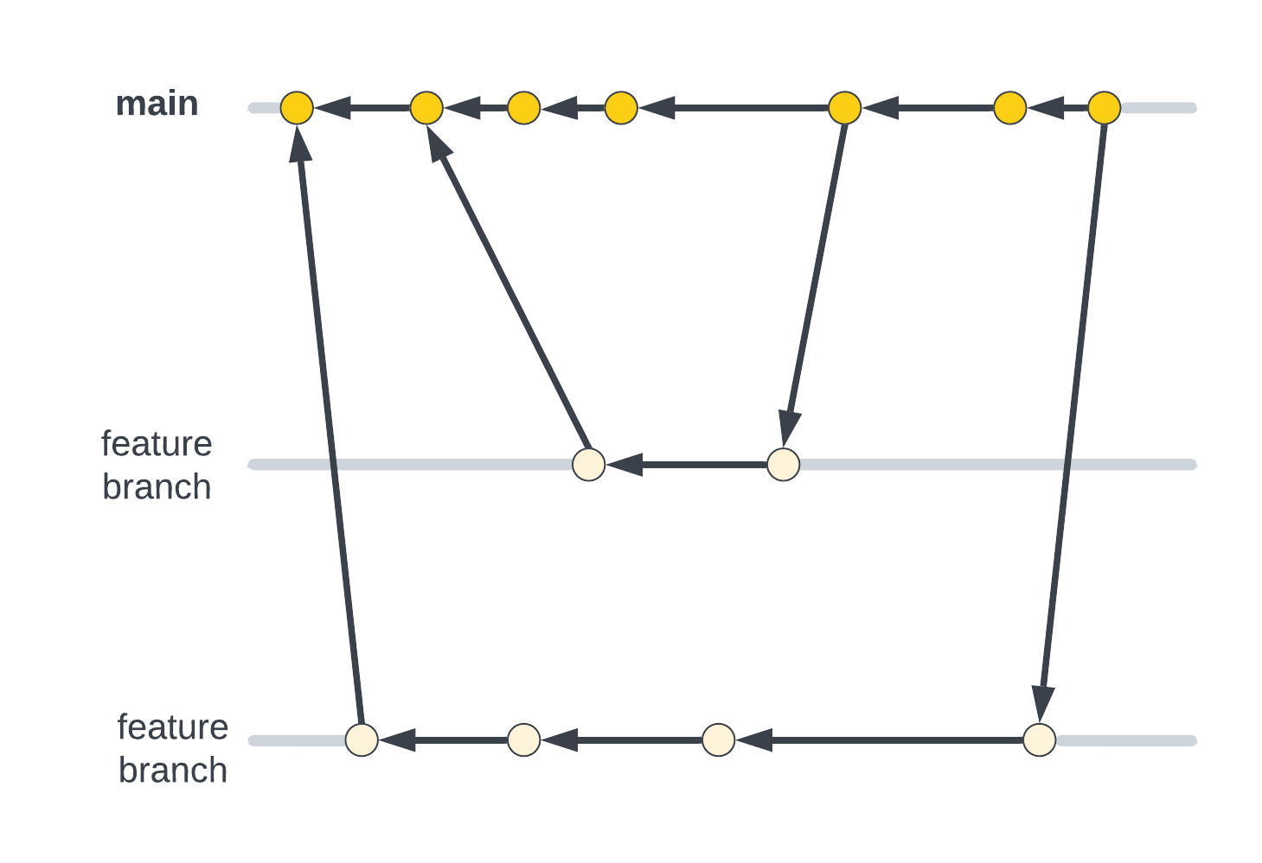

Slide 36
git branch
List, create, or delete branches
Notes:
git branch bug-fix
cat .git/refs/heads/bug-fix

Slide 37
.git Folder After “git branch”
├── HEAD
├── config
├── description
├── hooks
├── index
├── info
│ └── exclude
├── objects
│ ├── ...
│ ├── info
│ └── pack
└── refs
├── heads
│ ├── bug-fix
│ └── main
└── tags

Slide 38
git tag
Create, list, or delete a tag object
Notes:
git tag v1.0
cat .git/refs/tags/v1.0

Slide 39
.git Folder After “git tag”
├── HEAD
├── config
├── description
├── hooks
├── index
├── info
│ └── exclude
├── objects
│ ├── ...
│ ├── info
│ └── pack
└── refs
├── heads
│ ├── bug-fix
│ └── main
└── tags └── v1.0

Slide 40
git tag
Lightweight Tags
Annotated Tags
Notes:
git tag r1 -m "Release 1 - Initial Release"
cat .git/refs/tags/r1
git cat-file -t <tag hash>
git cat-file -p <tag hash>

Slide 41
.git Folder After “git tag -m”
├── ...
├── objects
│ ├── ...
│ ├── 04
│ │ └── 47d2b07e98b564d51ade6d28f05ad1de95438e
│ ├── ...
│ ├── info
│ └── pack
└── refs
├── heads
│ ├── bug-fix
│ └── main
└── tags ├── r1
└── v1.0

Slide 42
Anatomy of an Annotated Tag Object
object d834426d708532320626b14b54401f108cd1a007
type commit
tag r1
tagger Matthew Heironimus <me@email.com> 1691517144 -0500
Release 1 - Initial Release

Slide 43
Git Object Types
blob – file contents
commit - point-in-time snapshot of the repository
tree – names of blobs in a directory
tag – annotated tag

Slide 44
HEAD
Last commit snapshot, next parent
Notes:
cat .git/HEAD
cat .git/refs/heads/main
HEAD is the pointer to the current branch reference, which is in turn a pointer to the last commit made on that branch. That means HEAD will be the parent of the next commit that is created. It’s generally simplest to think of HEAD as the snapshot of your last commit on that branch.
git log
git switch bug-fix
git log
cat .git/HEAD
git log
cp another.txt subfolder/another.txt
git status
git add subfolder/another.txt
Note: nothing changed in .git because this object already exists
git status
git ls-file -s
git commit -m "First commit on bug-fix"
cat .git/HEAD
cat .git/refs/heads/bug-fix
cat .git/refs/heads/main

Slide 45
git reset
Reset current HEAD to the specified state
Notes:
Changes the current branch HEAD
Back out my last commit
git reset --soft HEAD~
git status
git log
The commit is still in the database, but it is just not on any named branches.
git commit -m "Changed comment on first commit on bug-fix"
git log

Slide 46
git reset - Modes
--soft : Resets the working tree but not the index
--mixed : Resets the index but not the working tree
--hard : Resets the index and working tree
Notes:
There are other options, but these are the ones you are most likely to use.
Backing out a “git add”
echo "version 4" > demo.txt
git add demo.txt
git status
git reset --mixed HEAD
git status
git reset --hard HEAD
git status
cat demo.txt
Re-doing a series of commits as a single commit
echo "version 4" > demo.txt ; git add demo.txt ; git commit -m "version 4"
echo "version 5" > demo.txt ; git add demo.txt ; git commit -m "version 5"
echo "version 6" > demo.txt ; git add demo.txt ; git commit -m "version 6"
git log
git reset --soft <commit to build off of>
git log
git status
git commit -m "Only one commit"
git log
git checkout <abandoned commit>
echo "version 5a" > demo.txt
git status
git add demo.txt
git status
git commit -m "Branchless commit"
git log
git switch bug-fix
git reflog

Slide 47
git reflog [show]
Shows reference log (reflog) information
Notes:
Defaults to showing HEAD. Has other subcommands for modifying the reference log.

Slide 48
What is Git?
Content-addressable Filesystem
Unique Key: SHA-1
Zlib Compression
Series of Snapshots
Each commit is a snapshot
Directed Acyclic Graph (DAG)
Notes:
review

Slide 49
References
Git - https://git-scm.com/
Git Source Code Mirror - https://github.com/git/git
SHA-1 - https://en.wikipedia.org/wiki/SHA-1
Pro Git - https://git-scm.com/book/en/v2
Head First Git - https://www.amazon.com/Head-First-Git-Learners-Understanding/dp/1492092517

Slide 50
Questions?

